Slide 1
Employee Management System
Presented BY ::
Sanjay Kumar
1803213128
IT(c)

Slide 2

Outline
Introduction
Features
Work Out
Tools and Languages
ER Diagram
DB Design
Certificate

Slide 3
Introduction
To manage and manipulate the basic employee data of an organization.
In our Employee Management System project, one can manage and manipulate the data of employees like employee Id, name, number, email, address, gender, and salary of an employee.
The main and important method is that we have a login system, where one can use MySQL credentials and login to the database and use it with secured data of employees

Slide 4
Features
Adding a new employee data.
Updating existing records.
Searching existing records.
Deleting a record in case of unwanted.
Fetching records from the database.
Showing the records on the console according to the function used

Slide 5
Features (Cont.)
Login system to connect database and to secure data.
Added time and date of a record.

Slide 6
Tools and Languages
Tools
1. IDE used : pycharm and jupyter notebook
Languages
1. python
2. python(Tkinter)
MySQL

Slide 7
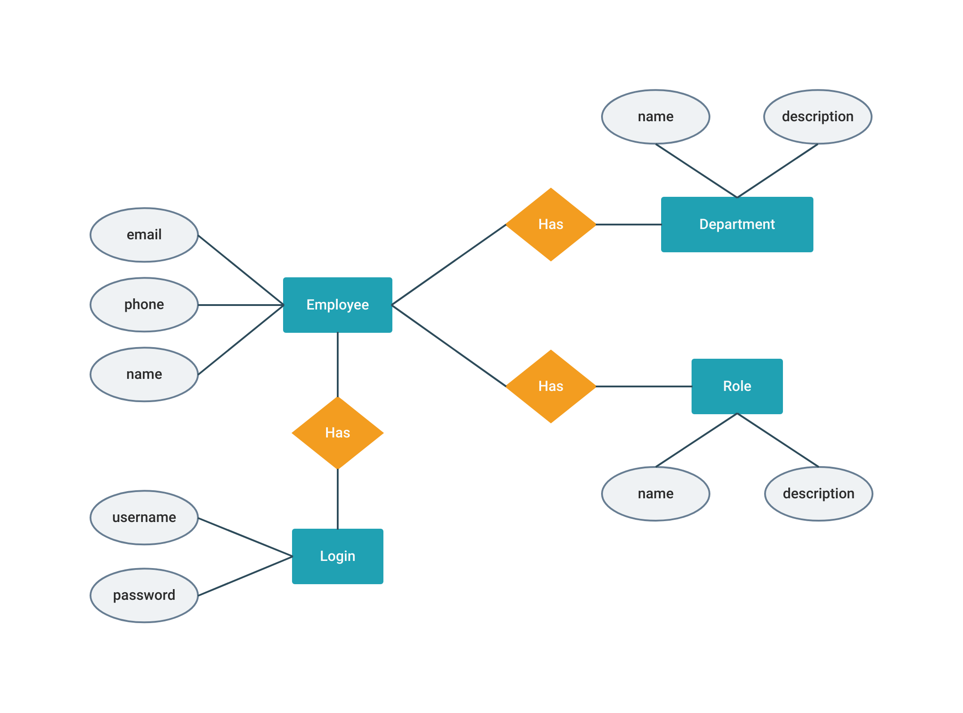
ER Diagram

Slide 8
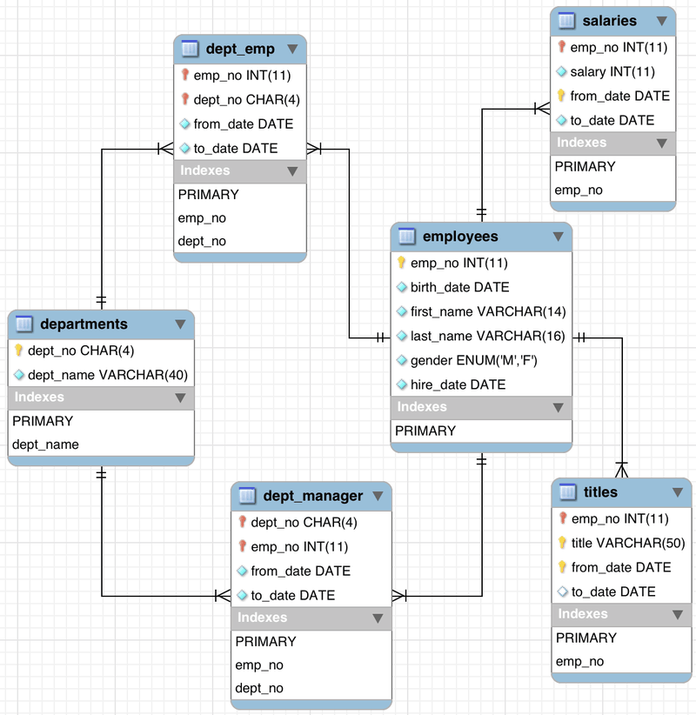
Database Design

Slide 9
Work out
Let's take a tour in our blog

Slide 10
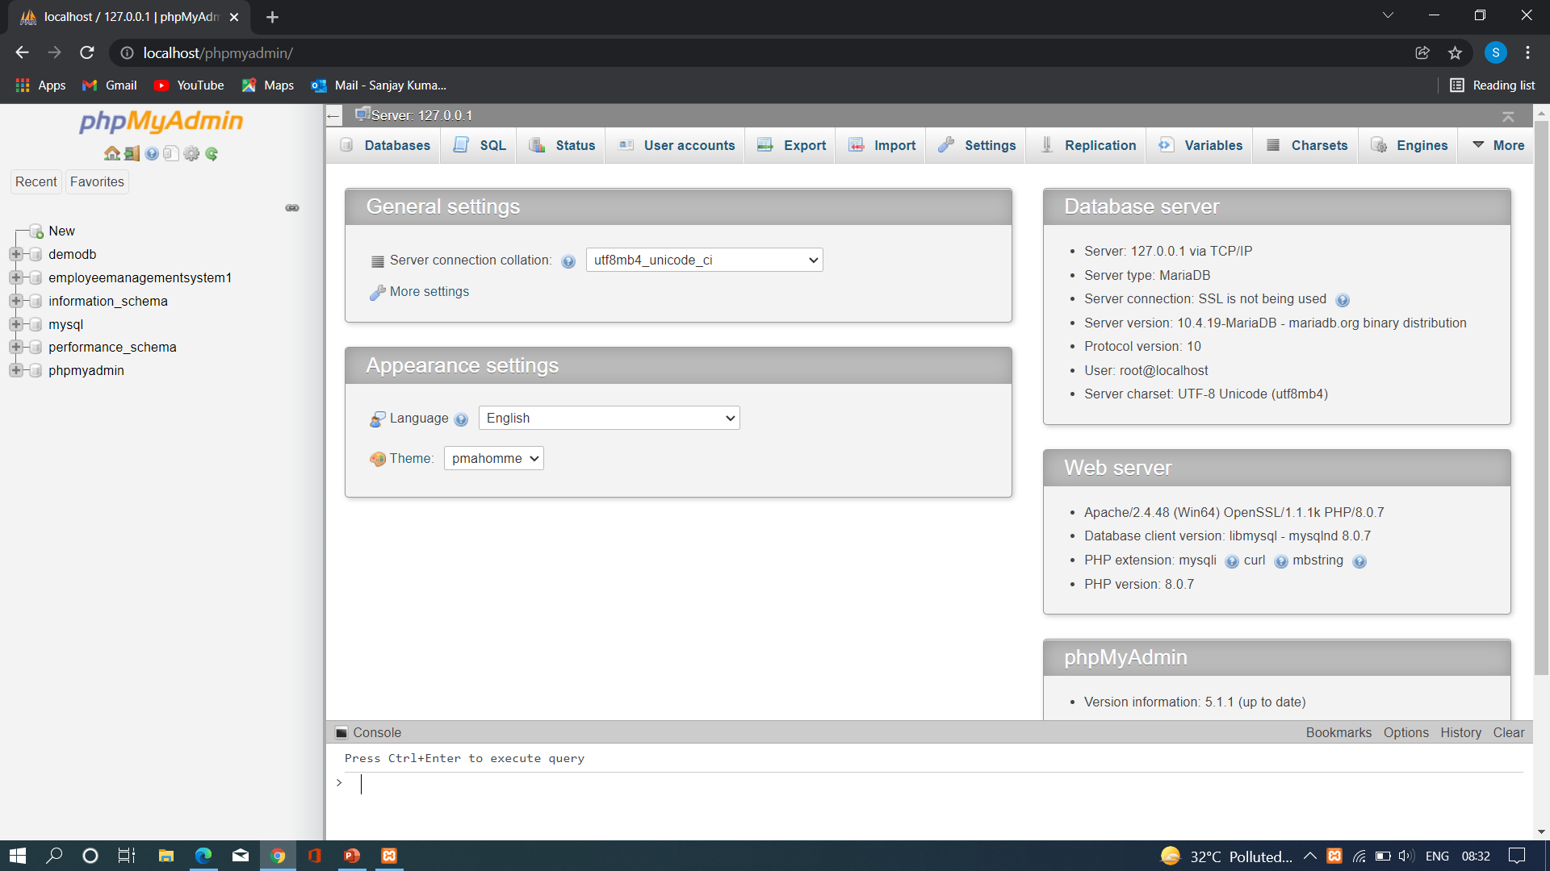

Slide 11
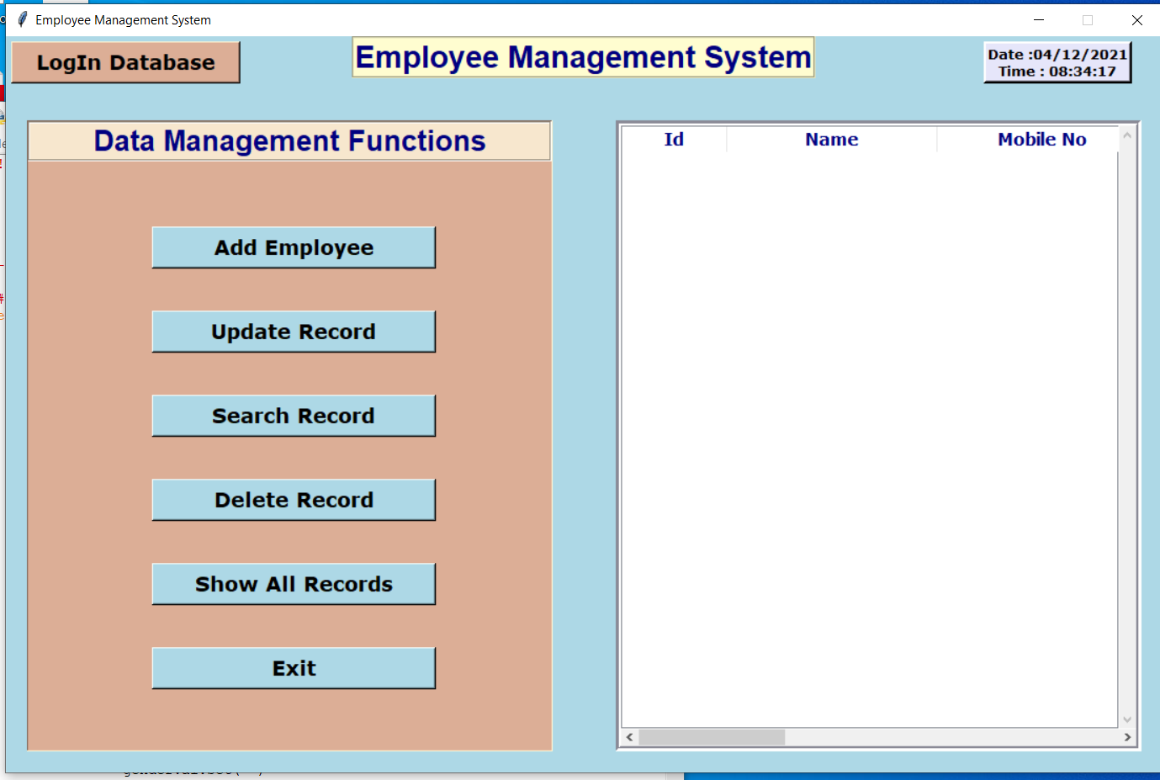

Slide 12
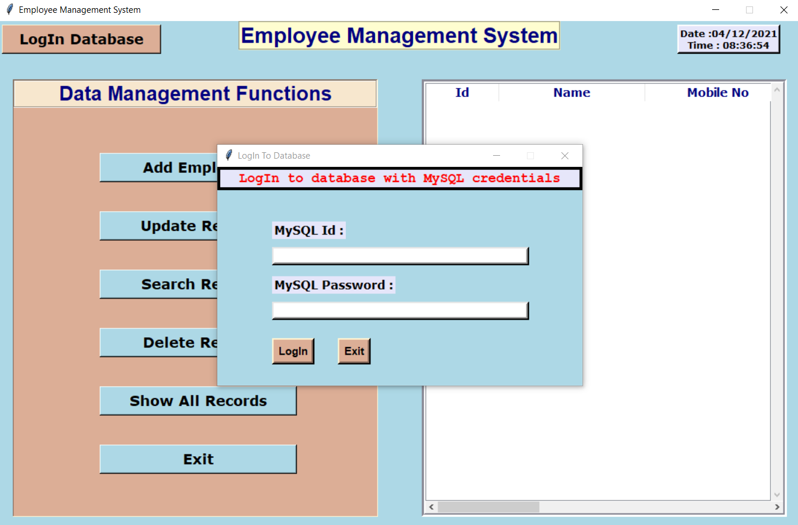

Slide 13
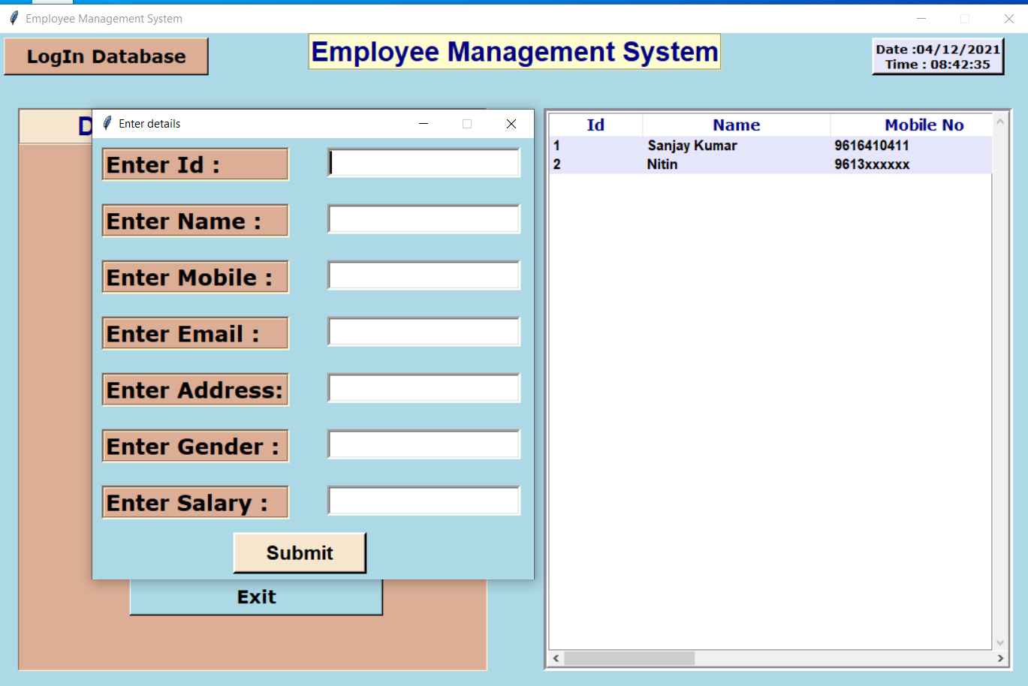

Slide 14
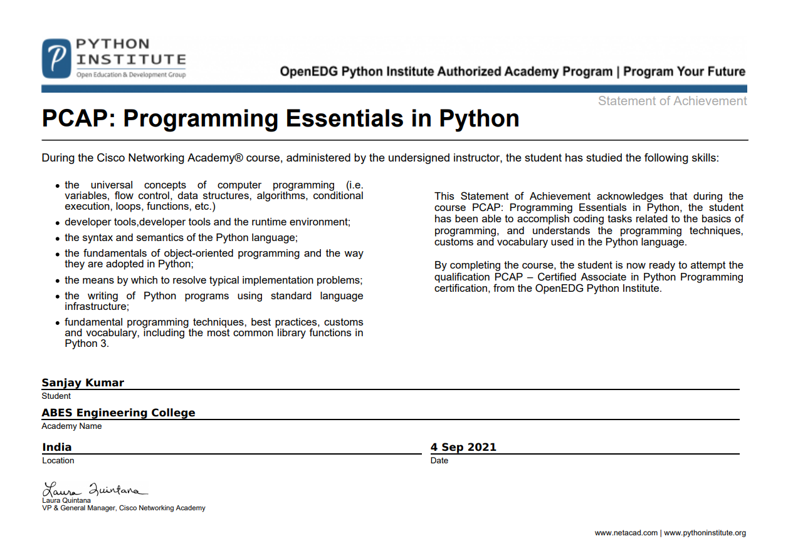
Certificate

Slide 15
Thank you

